Slide 1
BREWERY SALES FORECASTING
BIA-678 WS
Team D
Shaun Mendes
Bhushan Vinod Karande

Slide 2
Table of Contents
Objective
Data Overview
Data Preprocessing
Feature Engineering
EDA
Model Details
Model Performance
Cloud Architecture
Issues
Cluster Configuration
Scale Out
Scale Up
Conclusion

Slide 3
Objective
The objective of this project is to predict and optimize beer sales using historical sales data alongside brewing parameters such as fermentation time, temperature, pH level, and seasonal trends. Addressing this problem involves developing predictive models that not only forecast total sales but also identify how production adjustments and seasonal factors can strategically influence sales outcomes.
PROBLEM STATEMENT
Sales Forecasting: Develop a model to forecast total sales based on historical data, beer style, batch characteristics, etc. This approach aims to optimize production and marketing strategies by understanding demand patterns.
Impact of Production Parameters on Sales: Explore how parameters such as Fermentation Time, Temperature, pH Level, and Gravity affect sales. Adjusting these variables based on model insights could significantly boost sales figures.
Predicting Sales Based on Seasonal Trends: Implement predictive model to estimate sales volumes influenced by seasonal trends. This will aid in planning the types and quantities of beer to produce throughout the year, maximizing seasonal appeal.

Slide 4

Data Overview
https://www.kaggle.com/datasets/ankurnapa/brewery-operations-and-market-analysis-dataset/
Overview: This dataset presents an extensive collection of data from a craft beer brewery, spanning from January 2020 to January 2024. It encapsulates a rich blend of brewing parameters, sales data, and quality assessments, providing a holistic view of the brewing process and its market implications.
Datapoints: 10 Million

Slide 5
Data Overview
Feature Variables:
Batch_ID: integer
Brew_Date: timestamp
Beer_Style: string
SKU: string
Location: string
Fermentation_Time: integer
Temperature: double
pH_Level: double
Gravity: double
Alcohol_Content: double
Bitterness: integer
Color: integer
Ingredient_Ratio: string
Volume_Produced: integer
Quality_Score: double
Brewhouse_Efficiency: double
Loss_During_Brewing: double
Loss_During_Fermentation: double
Loss_During_Bottling_Kegging: double
Target Variables: Total_Sales: double

Slide 6
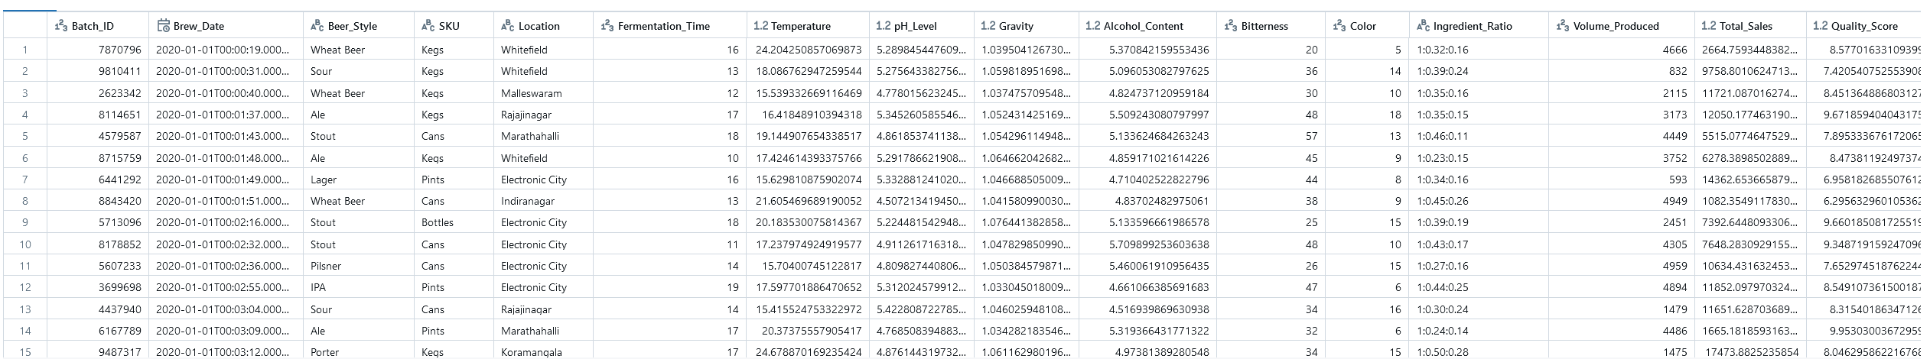
Data Overview

Slide 7
Data Preprocessing
Feature Engineering:
Drop duplicates
Impute Missing values – Drop/Replace with mean or most common category
Categorical columns – Replace with numbers or One hot encoding
Timestamp – Converting it to machine friendly. For eg: 2020-01-01 was divided into Year, Month and Day

Slide 8
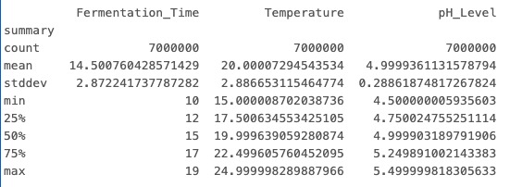
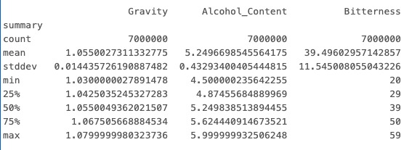
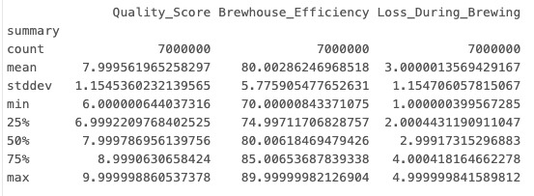
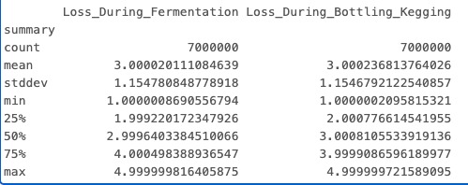
Data Preprocessing
EDA:
Continuous Variables

Slide 9
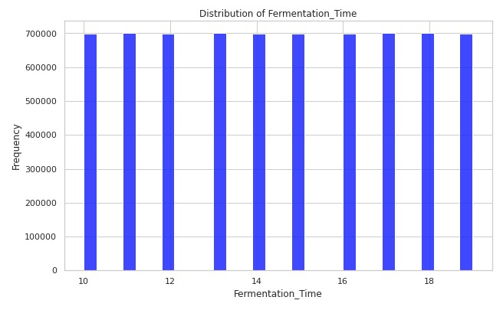
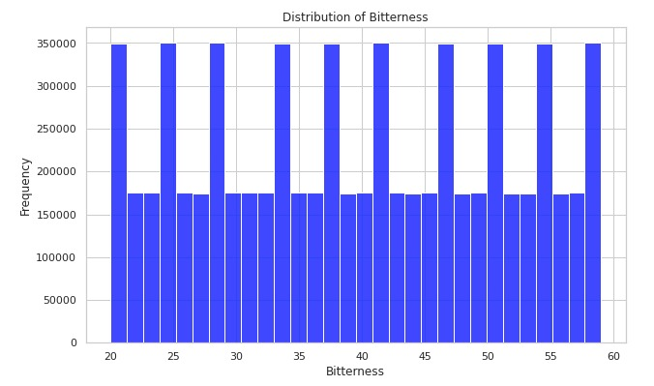
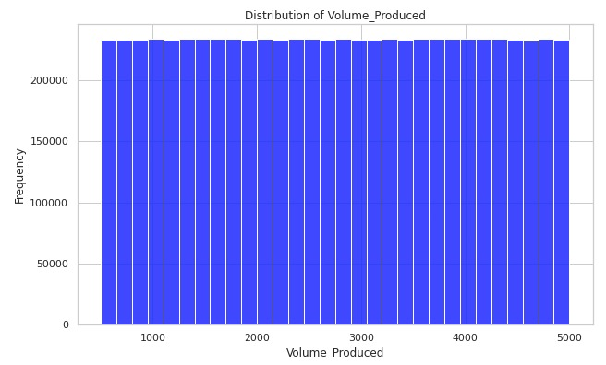
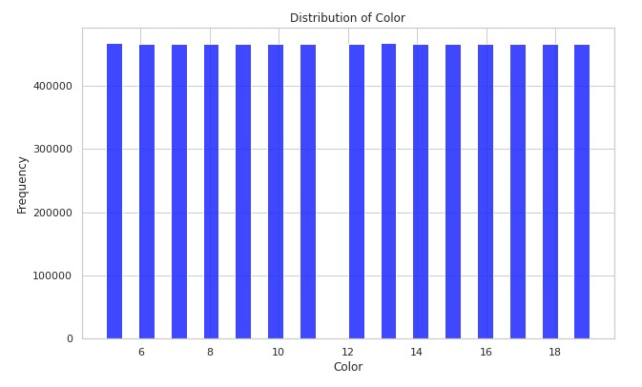
Data Preprocessing
EDA:
Categorial Variables

Slide 10
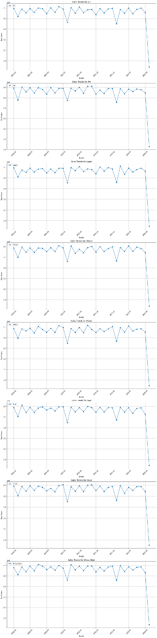
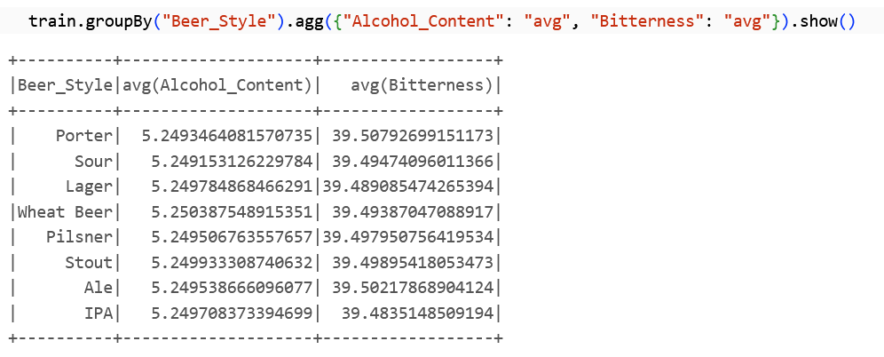
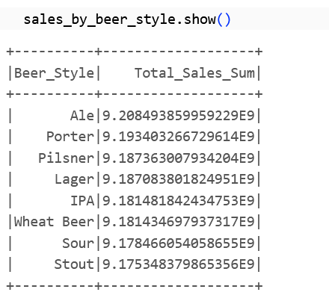
Data Preprocessing
Target Analysis: 7M Datapoints

Slide 11
Model Details
 | Model | Hyperparameters
Baseline | Linear Regression | regParam, solver
Tree | Decision Tree | maxDepth, maxBins
Ensemble | Random Forest | numTrees, maxDepth, maxBins

Slide 12
Model Performance
Model | RMSE | Hyperparameters
Linear Regression | 5486 | regParam, solver
Decision Tree | 5490 | maxDepth, maxBins
Random Forest | 5490 | numTrees, maxDepth

Slide 13




Cloud Architecture

Slide 14
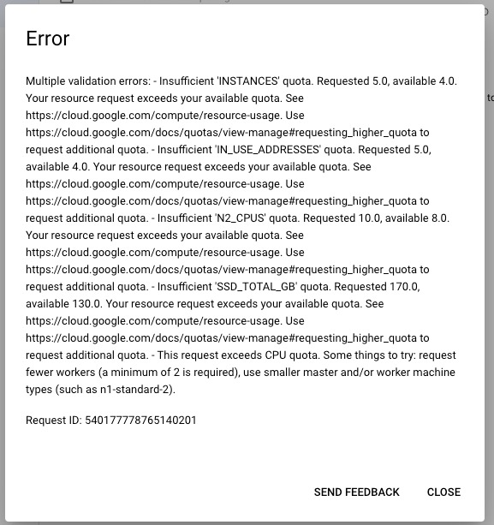
Issues
Cluster Creation Permissions
Resolution: Create IAM roles based on bucket and API availability
Scaling up
Resolution: Maximum number of workers that could be used was 3
Scaling Out
Resolution: Split Based on Years

Slide 15
Cluster Config
Workers | Config
1 | 1 Master: 2 vCPU, 1 core, 8GB Memory 0 Worker Disk Size : 50GB each
2 | 1 Master: 2 vCPU, 1 core, 8GB Memory 2 Worker: 2 vCPU, 1 core, 8GB Memory Disk Size : 50GB each
3 | 1 Master: 2 vCPU, 1 core, 8GB Memory 3 Worker: 2 vCPU, 1 core, 8GB Memory Disk Size : 50GB each

Slide 16
Scaling Out
Workers | Linear Regression | RMSE
1 | 15mins 4sec | 5486
2 | 12mins 28 sec | 5486
3 | 10mins 8sec | 5486

Slide 17
Scaling Out
Workers | DecisionTree | RMSE
1 | 13min 23sec | 5490
2 | 11min 49sec | 5490
3 | 9mins 8sec | 5490

Slide 18
Scaling Out
Workers | Random Forest | RMSE
1 | 15min 47sec | 5490
2 | 7min 55sec | 5490
3 | 6min 1sec | 5490

Slide 19
Scaling Up
Config: 1 Master 1 Workers Model: Linear Regression
Data | Time Taken
25% | 8min 51sec
50% | 13min 42sec
75% | 14min 47sec

Slide 20
Scaling Up
Config: 1 Master 2 Workers
Model: Linear Regression
Data | Time Taken
25% | 4mins 15 sec
50% | 7 min 45 sec
75% | 10 min 15 sec

Slide 21
Scaling Up
Config: 1 Master 3 Workers
Model: Linear Regression
Data | Time Taken
25%
50%
75%

